Slide 1
BlackBox Testig
Usecase testing

Slide 2
Introduction
Previously, Input variables with their ranges and boundaries, business rules as represented in decision tables, and system behaviors as represented in state-transition diagrams.
Now it is time to consider test cases that exercise a system's functionalities from start to finish by testing each of its individual transactions.
Defining the transactions that a system processes is a vital part of the requirements definition process.
Various approaches to documenting these transactions have been used in the past. Examples include flowcharts, HIPO diagrams, and text.
Today, the most popular approach is the use case diagram.

Slide 3
Introduction
Like decision tables and state-transition diagrams, use cases are usually created by developers for developers.
But, like these other techniques, use cases hold a wealth of information useful to testers.
Use cases were created by Ivar Jacobsen and popularized in his book Object-Oriented Software Engineering: A Use Case Driven Approach. Jacobsen defines a "use case" as a scenario that describes the use of a system by an actor to accomplish a specific goal.

Slide 4
Usecase
By "actor" we mean a user, playing a role with respect to the system, seeking to use the system to accomplish something worthwhile within a particular context.
Actors are generally people although other systems may also be actors.
A "scenario" is a sequence of steps that describe the interactions between the actor and the system.
Note that the use case is defined from the perspective of the user, not the system.
The set of use cases makes up the functional requirements of a system.

Slide 5
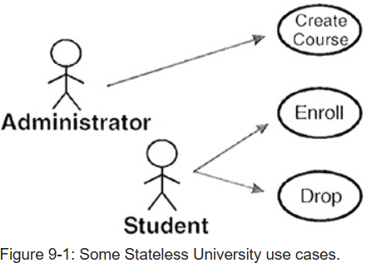
Usecase
The Unified Modeling Language notion for use cases is:
The stick figures represent the actors, the ellipses represent the use cases, and the arrows show which actors initiate which use cases.

Slide 6
Usecase
The value of use cases is that they:
Capture the system's functional requirements from the user's perspective; not from a technical perspective, and irrespective of the development paradigm to be used.
Can be used to actively involve users in the requirements gathering and definition process.
Provide the basis for identifying a system's key internal components, structures, databases, and relationships.
Serve as the foundation for developing test cases at the system and acceptance level.
Notes:
Imagine a bank is redesigning its customer interface. The stakeholders include business analysts, customers, and developers who are debating whether to use an Angular front-end or a React front-end, and whether to use a monolithic or microservices architecture on the backend
Imagine a software team is building a document management system. The business analyst (BA) knows the system needs a "File Upload" feature, but they don't know the user's practical workflow or their specific anxieties about the process.
Imagine a financial institution is developing a new online loan system. An external dependency relationship with a third-party credit score provider.
Imagine an e-commerce platform is being built. The Use Case is "Checkout and Pay."

Slide 7
Usecase Template

Slide 8
Usecase Example

Slide 9
Test case
To test the implementation, the basic rule is to create at least one test case for the main success scenario and at least one test case for each extension.
Because use cases do not specify input data, the tester must select it. Typically we use the equivalence class and boundary value techniques described earlier
To create test cases, start with normal data for the most often used transactions. Then move to boundary values and invalid data.
Next, choose transactions that, while not used often, are vital to the success of the system (i.e., Shut Down The Nuclear Reactor).

Slide 10
Test case
Try transactions in strange orders. Violate the preconditions (if that can happen in actual use).
If a transaction has loops, don't just loop through once or twice—be diabolical.
Look for the longest, most convoluted path through the transaction and try it.
If transactions should be executed in some logical order, try a different order. Instead of entering data top-down, try bottom-up.
Create "goofy" test cases. If you don't try strange things, you know the users will.

Slide 11
Test case
Most paths through a transaction are easy to create.
They correspond to valid and invalid data being entered.
More difficult are those paths due to some kind of exceptional condition— low memory, disk full, connection lost, driver not loaded, etc.
It can be very time consuming for the tester to create or simulate these conditions
Fortunately, a tool is available to help the tester simulate these problems—
Holodeck, created by James Whittaker and his associates at Florida Institute of Technology. Holodeck monitors the interactions between an application and its operating system. It logs each system call and enables the tester to simulate a failure of any call at will. In this way, the disk can be "made full," network connections can "become disconnected," data transmission can "be garbled," and a host of other problems can be simulated.

Slide 12
Application and Limitations
Transaction testing is generally the cornerstone of system and acceptance testing.
It should be used whenever system transactions are well defined
While creating at least one test case for the main success scenario and at least one for each extension provides some level of test coverage
it is clear that, no matter how much we try, most input combinations will remain untested.
Do not be overconfident about the quality of the system at this point.

